Slide 1
Higher Education Prediction System using AI
Guided By : Mr. Sufyan P.
Members : Muhammed Fairoos M (MEA16CS052)
Sahad K (MEA16CS065)
Nishad K (LMEA16CS089)

Slide 2
Outline
Introduction
Objective
Literature Survey
Proposed system
Implementation
System design
Conclusion
References

Slide 3
Introduction
How to predict students’ performance is always a question concerned by the students’ teachers and parents.
Based on the past examination results and aptitude assessments, it is possible to forecast the future development of the students.
Various type of data mining techniques had been used for performance prediction for decades.
Here, we will investigate how to use artificial intelligence and deep learning algorithm for assessment of results.

Slide 4
Objective
To predict students future development using AI.
Investigate how to use artificial intelligence algorithm for the prediction.
Attributes analyzed are the academic performances and an aptitude test.
Students will be getting which college they should be joined as of their performances.
This system helps students to perform for the admission test online and provides college list according to the marks.

Slide 5
Literature Survey
Topic | Authors | Conclusion
Artificial Neural Network (ANN) classifier to predict the performance of students in Mathematics. | I. E. Livieris | The modified spectral Perry trained artificial neural network performs better classification compared to other classifiers.
Preventing student dropout in distance learning systems using machine learning techniques Applied AI | S. Kotsiantis | An algorithm was fed on several project assignment rather than class performance data to make prediction of students.

Slide 6
Proposed System
The proposed system consists of following Users,
Students
Registration / login.
Input the marks.
Writing aptitude test.
View results.
Gets the details of appropriate college as per their performance.
View their mark in form of bar graph with possible stream and students can view their college list.
Student can give their feedback about the whole process

Slide 7
Proposed System (Cont…)
Admin
Admin can add all stream detail.
Admin can add college detail, Stream and cut off list.
Admin can update college detail.
Admin can add questions for aptitude test.
Admin can view student detail.
Admin can view all the feedback given by students.

Slide 8
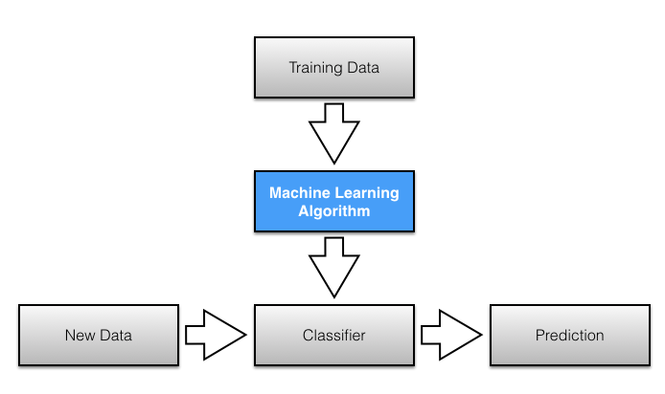
Implementation

Slide 9
Implementation (Cont…)
Technologies Used
Tensor Flow
Tensor Flow is a free and open-source software library for dataflow and differentiable programming across a range of tasks
Deep Learning
Deep learning is a subset of ML in AI that has networks capable of learning unsupervised from data that is unstructured or unlabeled.
Web Application
A web application is developed using HTML for the interface

Slide 10
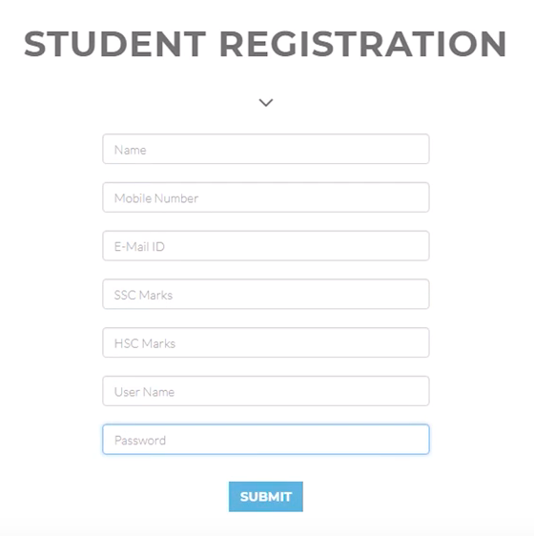
System Design
Student Registration/ Login
Candidate who is applying for the test must first create an account in the system by registering themselves and then can login into the account to begin with test.
Register : Student can register their details.

Slide 11
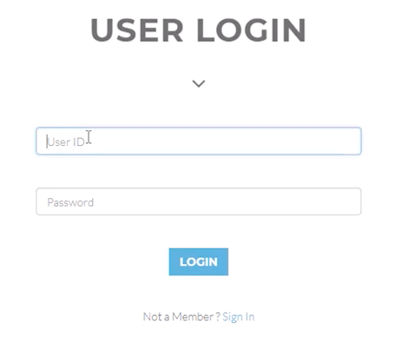
System Design (Cont…)
Login : Students can login using their username and password

Slide 12
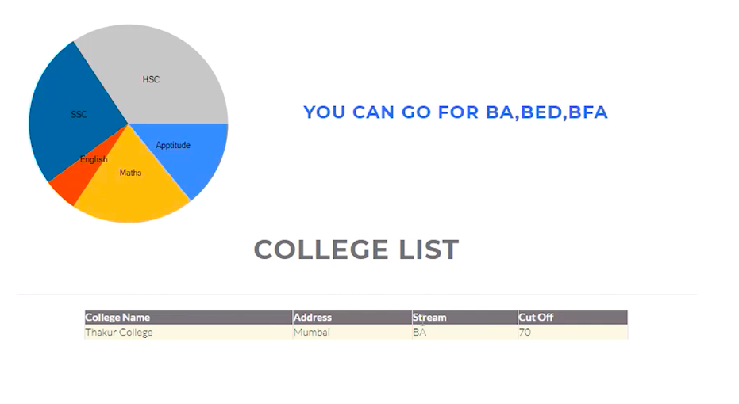
System Design (Cont…)
Insert Marks : Students can insert their marks.
Take Test : Students can give aptitude test.
Marks : Students can view their mark in form of graph with possible stream and students can view their college list.

Slide 13
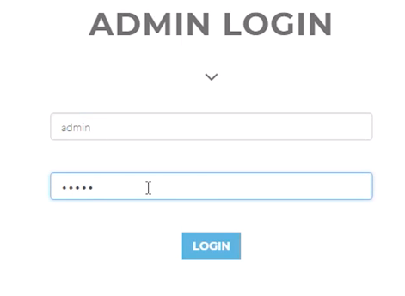
System Design (Cont…)
Admin Login
Login : Admin can login to the system

Slide 14
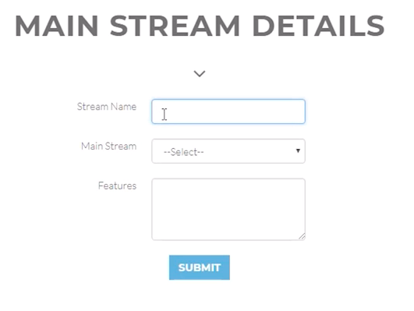
System Design (Cont…)
Add Streams : Admin can add streams to the system

Slide 15
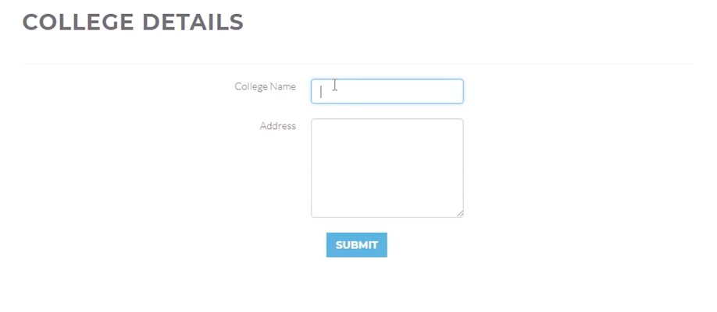
System Design (Cont…)
Add College : Admin can add college to the system

Slide 16
System Design (Cont…)
Add questions : Admin can add questions for the aptitude test.
Add training data : Admin can add training data to the system.
View students.
View feedback.

Slide 17
Conclusion
A deep neural network model is proposed in this paper for predicting the students’ performance.
This model is reliable and can help to predict a student’s performance .
The prediction result is good enough to provide appropriate recommendations for students, their teachers and parents to decide their development pathway.
It is believed that more applications of deep learning could be used for education and corporate staff training in the future.

Slide 18
References
Wilton W.T. Fok1, Y.S. He1, H.H. Au Yeung1, K.Y. Law1, KH Cheung1, YY. Ai1, P. Ho1 , “Prediction Model for Students’ Future Development by Deep Learning and Tensorflow Artificial Intelligence Engine ”, IEEE, 2018.
Livieris, et al. (2012): Predicting students' performance using artificial neural networks 8th PanHellenic Conference with International Participation Information and Communication Technologies, pp.321-328.
S. Kotsiantis, et al. (2003): Preventing student dropout in distance learning systems using machine learning techniques Applied Artificial Intelligence, 18(5), pp.411- 426.
Amrieh, E.A., Hamtini, T. and Aljarah, I., 2016. Mining Educational Data to Predict Student’s academic Performance using Ensemble Methods. International Journal of Database Theory and Application, 9(8), pp.119-136.

Slide 19
THANK YOU

